Slide 1

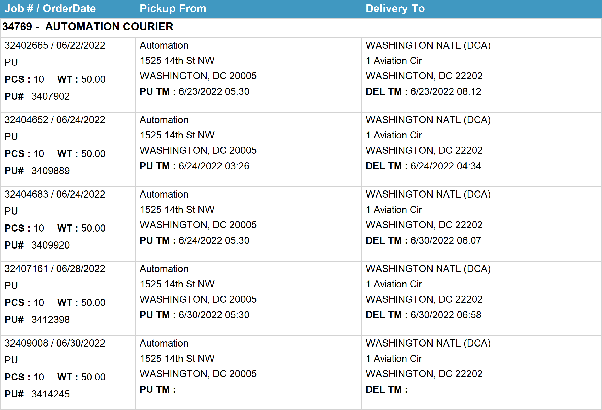
Agent Activity Report
*Data provided should be considered CONFIDENTIAL and PROPRIETARY*
©2011-2022 MNX Global Logistics. All rights reserved.
6/30/2022 10:22 PM
Print User : automation

Slide 2
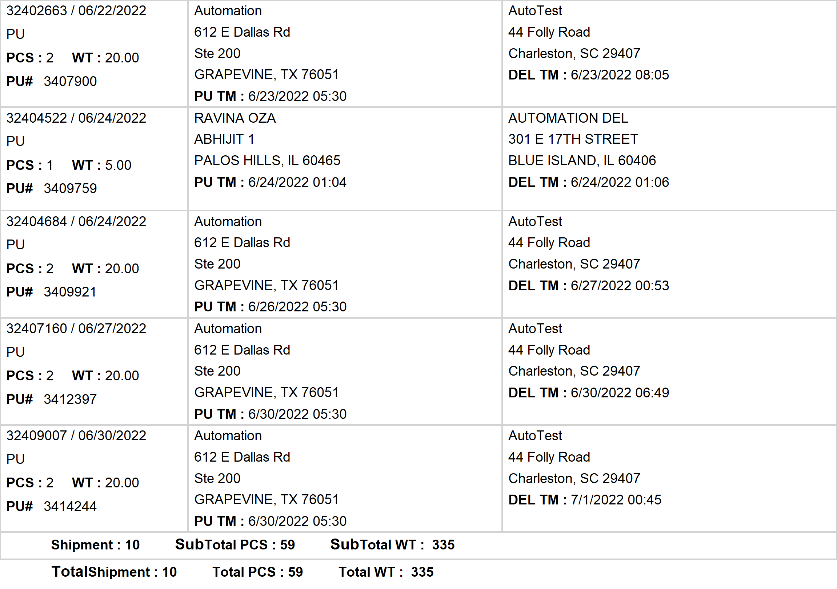
Agent Activity Report
*Data provided should be considered CONFIDENTIAL and PROPRIETARY*
©2011-2022 MNX Global Logistics. All rights reserved.
6/30/2022 10:22 PM
Print User : automation

Slide 3
Agent Activity Report
*Data provided should be considered CONFIDENTIAL and PROPRIETARY*
©2011-2022 MNX Global Logistics. All rights reserved.
6/30/2022 10:22 PM
Print User : automation

